Slide 1
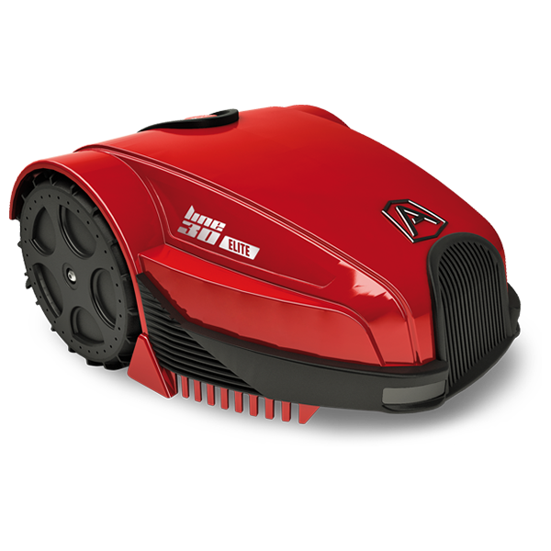
Lawn Mower Robot
by Klára Boldizsárné Kormos
Code: https://github.com/kormoska/LawnMowerRobot

Slide 2
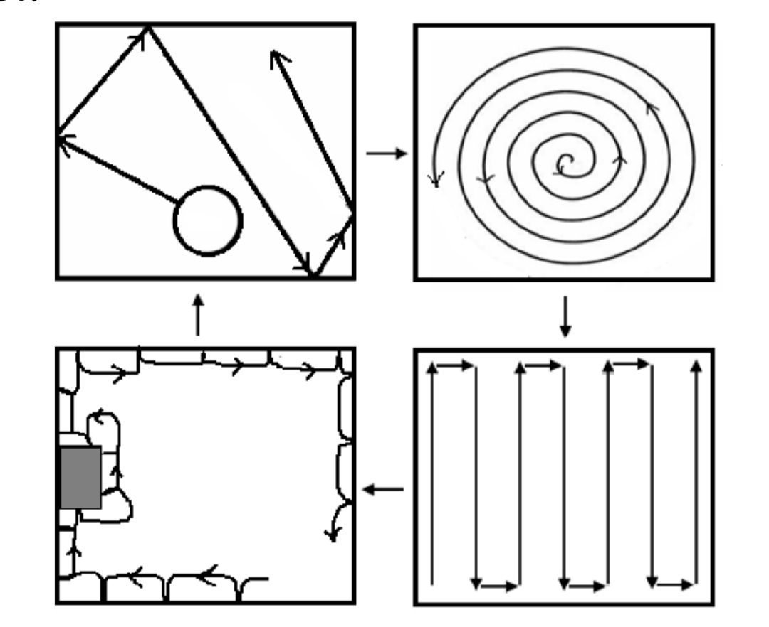
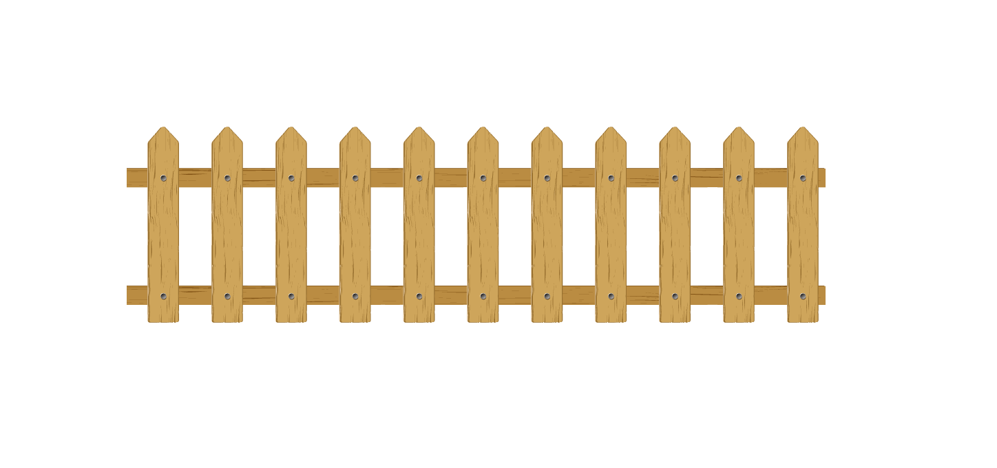
Problem
Path planning of the coverage region (PPCR) avoiding obstacles
Known algorithms – random walk, spiral, ‘S’ shape, wall follow... genetic algorithm (GA)
Goal: complete coverage with minimise the amount of turn,trajectory lenght and multiple visits of the same place

Slide 3





Algorithm
P+(0,1)
Robot simple behaviour, moves four direction
Left, right, up and down
Map Dictionary<Coords,int> value: how many times visited
Init Charger Point: start and end point
Steps:
Examine the 4 neighbours, is it in the Map
if not ask Garden is it border(wall/obstacle)?
is border => Add to Map (Coords, int.MaxValue)
not border => Add to Map (Coords,0)
Choose the neighbour with smallest visited value,
move Position there and increase the value +1
End condition question
P+(-1,0)
P+(1,0)
P+(0,-1)

Slide 4
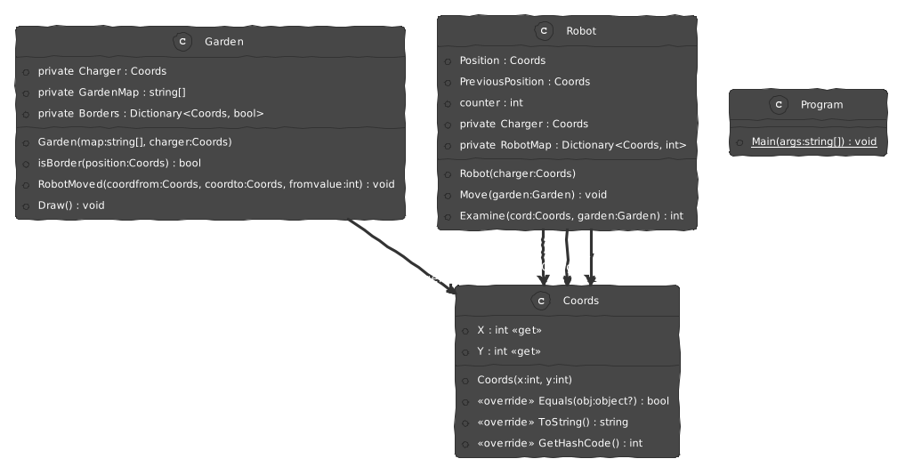
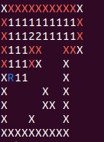
Realization
Tools:
C# .NET6
VS Code 1.73.1
Ubuntu 22.04.1

Slide 5

Thanks !
Does anyone have any questions?

